Slide 1

Basics of Neural Network Programming
Derivatives
deeplearning.ai
Notes:
Let us get an intuitive understanding of calculus & derivatives. We

Slide 2
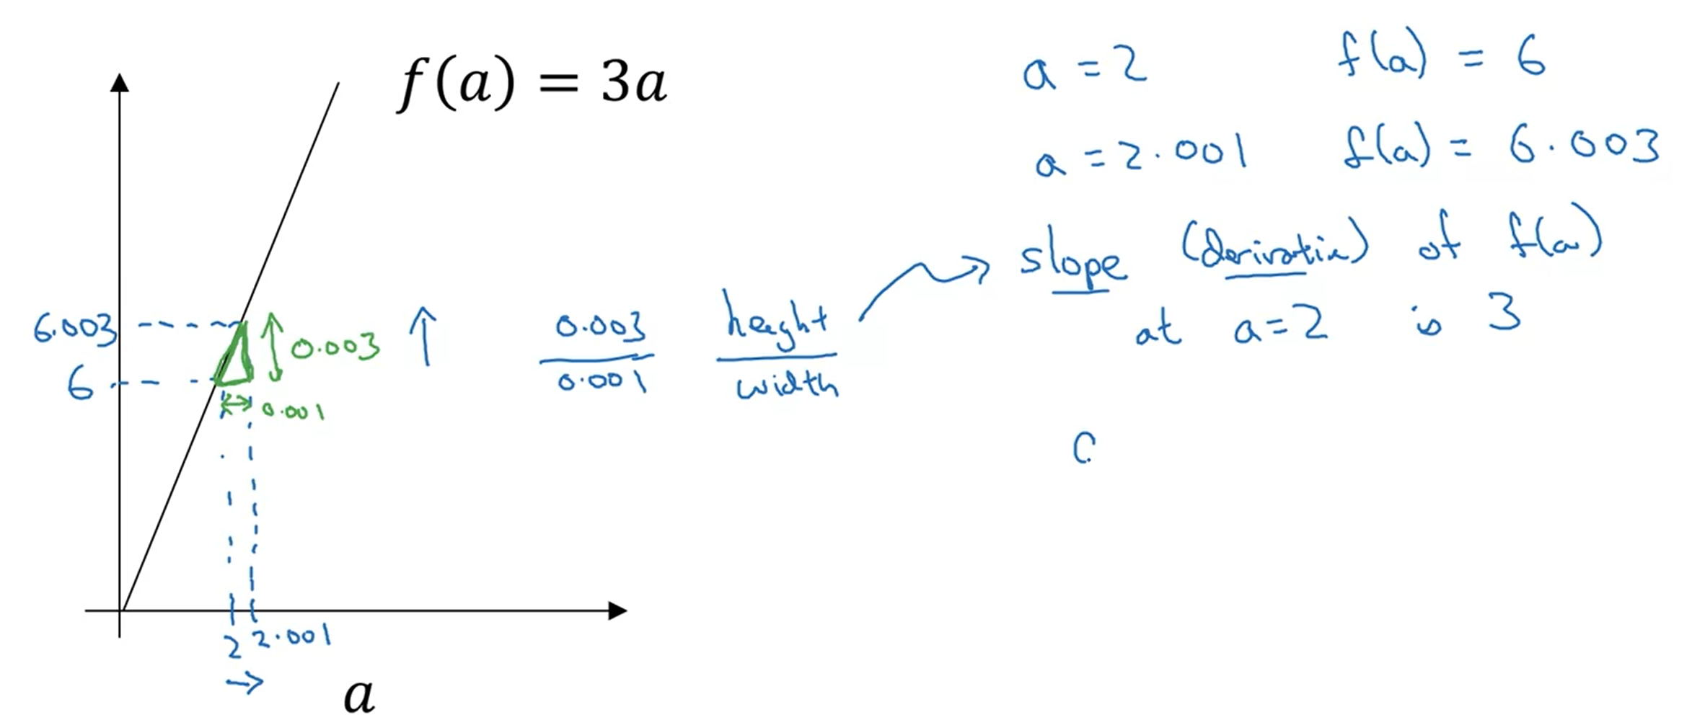
Intuition about derivatives
Notes:
Slope is a friendlier way of saying derivative.
Now here, we have drawn a function f(a) = 3a, as shown in the graph, if a = 2, we get f(a) as 6. A slight increase in a will result in some increase in function value as well.
Now, the green triangle shows this phenomena of increase in the F(a) value with increase in a value.
The slope here is rise over run or height over width. The height for that triangle will be 6.003 – 6 = 0.003 & similarly the width will be 0.001

Slide 3

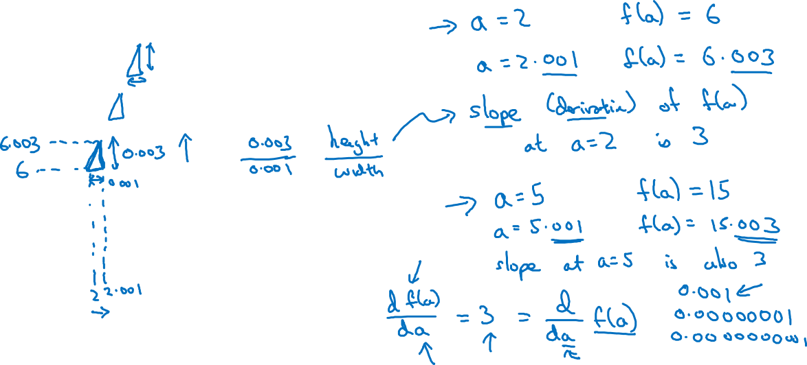

Intuition about derivatives
$$f\left(a\right)=3a$$
$$a$$
Notes:
Now, building upon, when we bump a slightly, f(a) goes 3 times up
As a result, we say, the slope in f(a) with increase in a as a derivative form which is shown in the slide.
Formally, for definition purposes, the value of bump are even more smaller & smaller.
One property of derivative, is that slope will remain same on all the points of the line.
However, in some functions which are not straight line the slope will not remain same for the function at each point

Slide 4
Basics of Neural Network Programming
More derivatives examples
deeplearning.ai

Slide 5

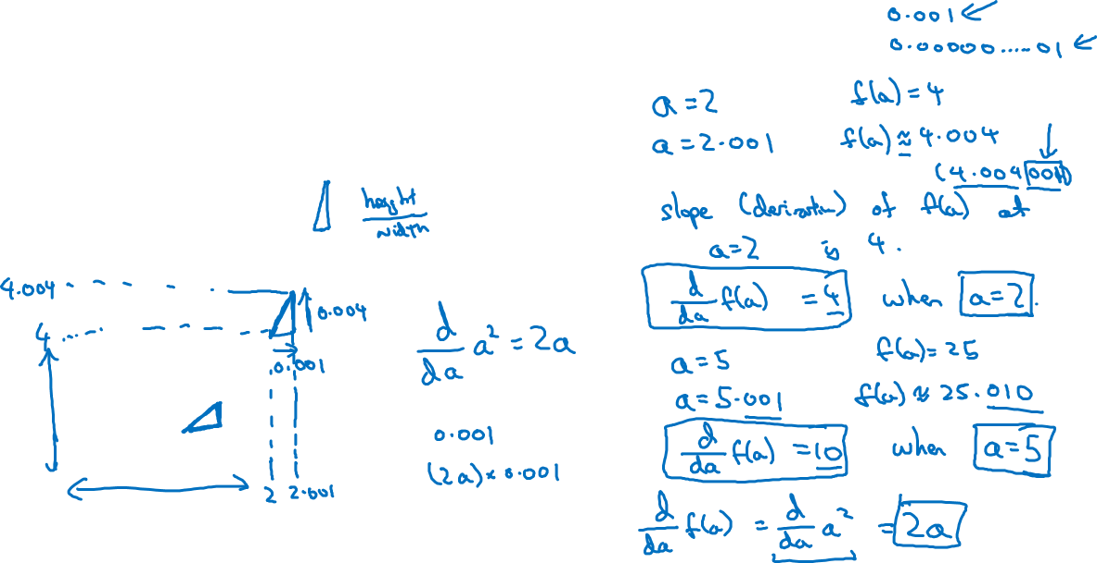

Intuition about derivatives
$$f\left(a\right)=a^{2}$$
$$a$$
Notes:
Derivative * the amount we change is the value of the function.
Derivative governs how much changing is happening.

Slide 6
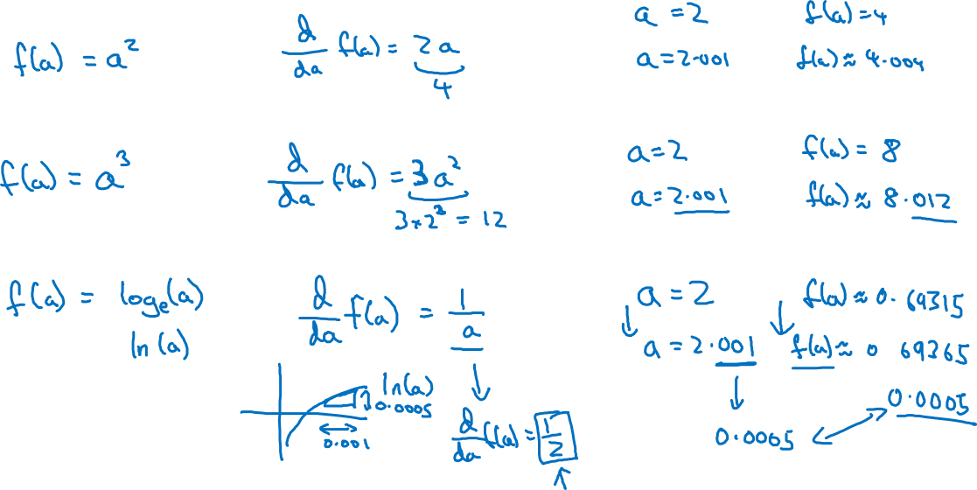
More derivative examples

Slide 7
More Derivatives Examples
Coursera

Slide 8
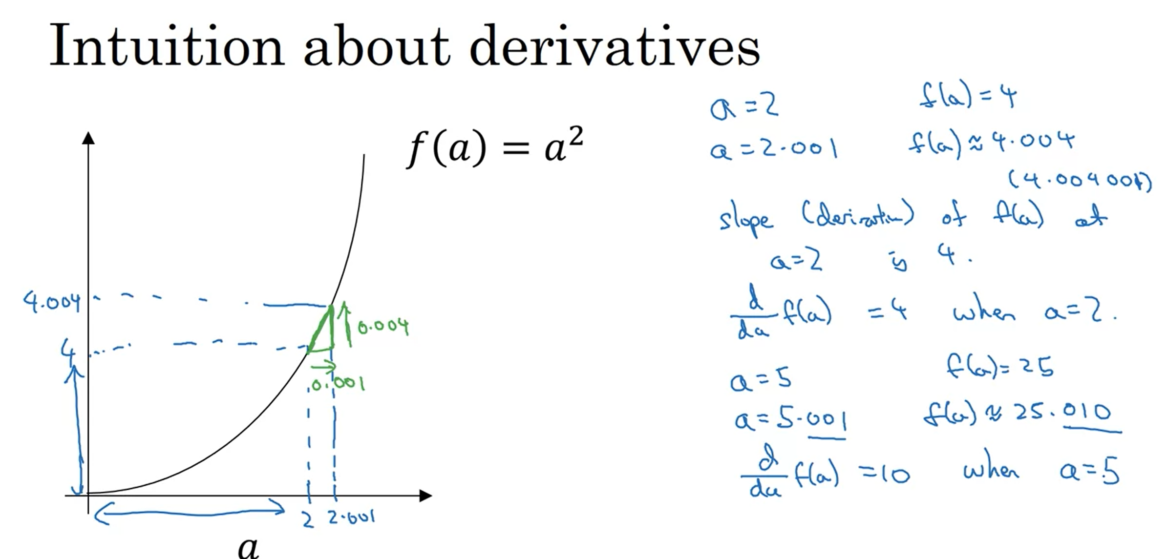
Intuition about derivatives
Notes:
In these examples, we study those examples when slope could be different at different points.
Here, we are taking the example of square function.
Now here, in the example of 5, if we nudge a by .001 the f(a) value becomes 25.010, where as f(a) value for 5 was 25. This shows that here the change of 0.001 caused a change of .010 in f(a) which is 10 times the change in a.
So the slope will be rise/run = 0.010/0.001 = 10
* Figures not drawn to scale.

Slide 9
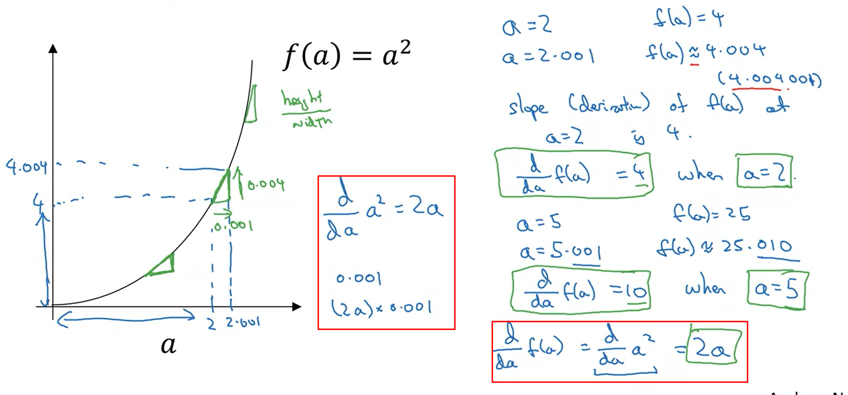
Calculus Book
Notes:
Another way to see & understand the derivative at different points is to see the ratio on triangles.
In calculus book, we see that the formula of derivative of a square is = 2a * the value which has been increased.
Here in the example, we see 4.004 because the value we nudged is not actually very small, therefore, if we nudge it by an infinitesimally small value than this term will go away.
This can be used to test the calculated gradients as well.

Slide 10
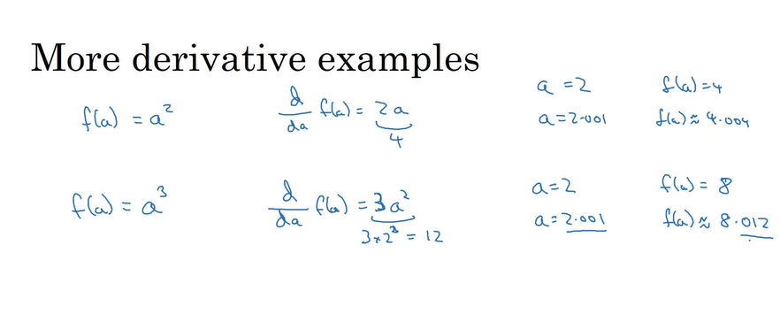
More Derivative examples
Notes:
This example states, that if we increase the value of a
Than increase in the value of f(a) will be given by its derivative which is what we have been discussing.
For example for a = 2, f(a) for the 2nd function gave value of 8
If we increase a slightly, than f(a) increase will be given by the derivative. We see that the value is 8.012 which means that the increase was (derivative)*the nudge
The derivative was 3*2 square = 12 and this value multiplies with the nudge which is 0.001 hence the 8.012

Slide 11
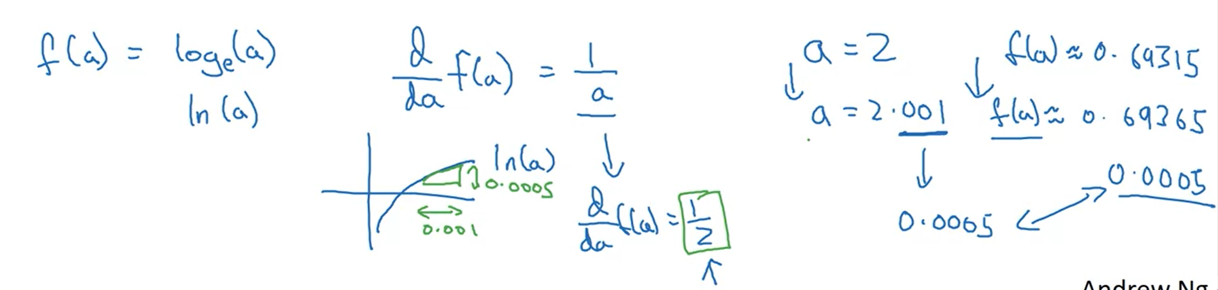
More Derivative examples – Log function
Notes:
So this formula shows that if we increase the value of a than the function value will increase by the derivative * increase in a
For example
a = 2 , than ln (a) = 0.69315
If we nudge a by a value 0.001
Than a = 2.001 & ln (a) = 0.69365
Now this increase in the value of function due the nudge is what is giuven by the derivative.
The derivative of function at a = 2 = 0.5
The increase in the function value after the nudge = 0.0005 which is derivative*nudge => ½ * 0.001

Slide 12
Takeaways
Derivative means slope
Slope can be different at different places for different functions
Slope of straight line is same for the line at each point.
If we want to look up the derivative.

